Slide 1


Introduction to the Power Platform
Gomolemo Mohapi Cloud Advocate, Microsoft
www.linkedin.com/in/gomomohapi
@GomoMohapi
Notes:
Thank you very much for giving me the chance to speak to you all and I hope you have all been inspired by the many sessions throughout this week! The party isn’t over yet and without any further ado I would like to share with you an Introduction to the Power Platform and how you, as students, can begin to leverage the various products within the Power Platform to start building solutions that meet your everyday needs and how the Power Platform can help accelerate your career.
My name is Gomolemo Mohapi and I am a Cloud Advocate at Microsoft focusing on Power Apps. I’m especially excited to be here talking to you guys since I started my journey at Microsoft as a student ambassador just a few short years ago so in many ways, I know, we can relate.

Slide 2


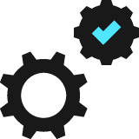

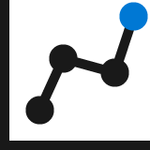




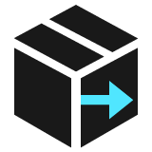
Organizations face various challenges today
Budget
constraints
Time & resource
constraints
Surging digital demand
Software development takes time
Tech skills
gap
Legacy system
maintenance
Evolving workforce expectations
Security &
compliance
Economic downturn
Shift to remote work
Notes:
Let’s get right into it! Let’s start with why the Power Platform is needed in today's world.
Across industries, organizations are working to drive value continuously with digital transformation efforts – doing so has become essential to business growth and evolution.
But even as organizations have more data and technology resources, digital transformation efforts still face challenges.
First, as technology systems evolve and innovation drives business successes, organizations are trying to overcome the constraints of legacy systems and paper-based processes. Beyond the inefficient processes and costs these systems give rise to, there is also now the major reality of remote work.
At the same time, today’s workforce demands customized, tech-savvy solutions and business applications. In the same way software has eaten the world in the consumer space, business applications and programs need to keep pace with the expectations of a younger and more technology-savvy workforce – this is where you come in.
To combat these challenges, businesses need better systems to make sense of their data, utilize and customize existing business applications, and provide better employee support and customer service. While the need is clear, it’s becoming hard for businesses to meet all of these requests with the resources on hand today, especially since the tech world faces a talent shortage. More than 85% of organizations struggle to find technical talent and the demand for mobile applications is growing at a faster rate than IT departments can deliver (1).
To top that, ground up software development takes time and is expensive. And building software inhouse brings with it a host of security and compliance considerations that require extensive upfront investments to ensure that applications run seamlessly and face no regulatory problems, hack, or data breach threats.
Needless to say, digital transformation is more important now than every, but major roadblocks remain.

Slide 3

There’s a constant rising demand for digital solutions
Notes:
Clearly, to help businesses meet these tech demands and grow - it requires an approach that utilizes digital technologies more efficiently and focuses on optimizing all of an organization’s resources, data, and talent.
Rapid and continued innovation and digital transformation is fast paving the way for how organizations conduct their business and how enterprise digital solutions are built and of course, how young talent solve problems.

Slide 4
The app gap challenge A growing demand for apps - but not enough developers to build them
500 million
new apps will be built in the next 5 years – more than all apps built in the last 40 years!¹
More than
1 Million
5x
Faster demand for mobile apps than IT departments can deliver.²
86%
of organizations struggle to find technical talent to build applications.³
¹ IDC FutureScape: Worldwide IT Industry 2020 Predictions. Doc # US 45599219, October 2019
² Gartner, How to Deliver Enterprise Mobile Apps Faster – 2017
³ Patrick Moorhead, Microsoft goes all-in on hybrid Cloud and Edge at Ignite 2019, citing Indeed survey, Forbes.com, Nov 2019
Notes:
So, this brings about the app gap challenge. Industries are moving to the cloud at a tremendous rate, and small businesses, career switches and students are taking part in this digital transformation. Many of these audiences have traditionally relied on manual or outdated methods that can’t keep up with quickly changing business needs or customer expectations of modern commerce. Additionally, 50 percent of tasks done in the workplace, could be automated with current technology, but it's going unautomated.
Over the next five years, more than 500 million digital apps and services will be developed and deployed. That is more than all the apps built in the last 40 years!
Demand for business applications is greater than ever, growing 5X faster than IT departments can deliver.² It’s no wonder then that 86% of organizations struggle to find technical talent. Everyone is really struggling to respond to this huge wave of digital transformation that they need to go complete.
So how can we scale traditional, code-first development in order to meet this growing demand…? That is the question we need to ask ourselves. And this is the question answered by…

Slide 5
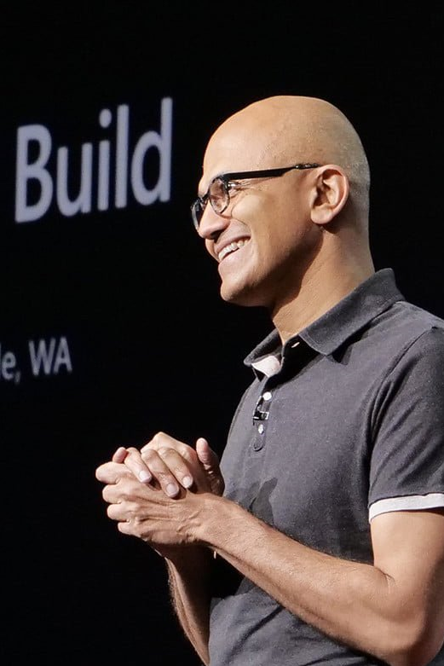

“Microsoft 365, Dynamics 365, and the Power Platform, on top of what we’re doing with Azure, is the core of what we are doing as a company.”
--Satya Nadella CEO, Microsoft
Notes:
The power platform! Which is one of the core pillars that Microsoft is investing in today – receiving major attention and investment throughout the organization and being at the center of all three Microsoft clouds – M355, Azure and D365.

Slide 6
What is Power Platform?
Notes:
So what is the power platform?

Slide 7
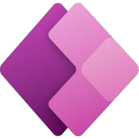










Microsoft Power Platform The low-code platform that spans Office 365, Azure, Dynamics 365, and standalone applications
Power Apps
Application development
Power Automate
Process automation
Power BI
Business analytics
Power Virtual Agents
Intelligent bots
Data connectors
AI Builder
Common Data Service
Management
Tools
Notes:
The Power Platform is a unified platform of low-code tools that spans Office 365, Azure, Dynamics 365, and standalone applications that helps you analyze data, build solutions, automate processes, and create virtual agents to revolutionise and digitize your life.
The Power Platform is a rapid app development platform that helps citizen developers with limited coding abilities to innovate and build new solutions faster in an environment and user experience that feels like PowerPoint and Excel.
Beyond use by citizen developers, Power Platform is a rapid application development and extensibility framework for professional developers that seamlessly integrates the high-speed capabilities of low-code tools and prebuilt components with no-cliffs extensibility across Azure and other professional development environments.
Power Platform truly is a transformative solution that brings together all kinds of developers and employees to collaborate and build solutions – whether no code, low code, or code first.
Let’s dive deeper into each of the four Power Platform products: Power Apps, Power Automate, Power BI, and Power Virtual Agents one by one.

Slide 8
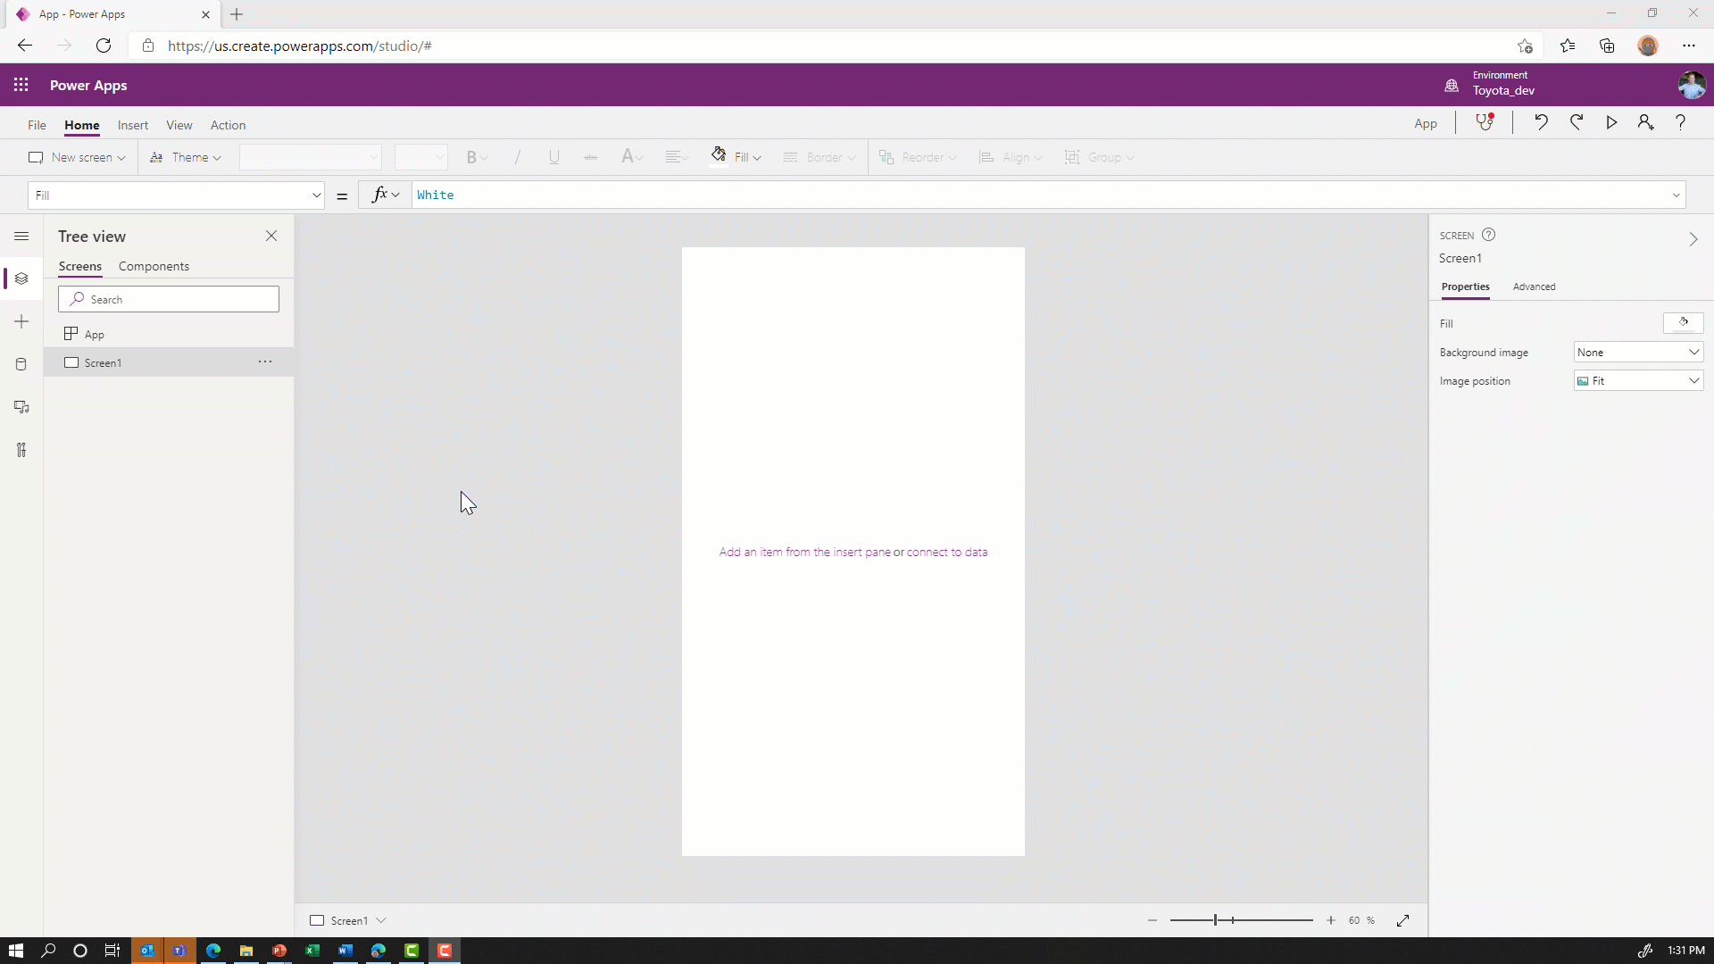

Power Apps Empower everyone to create apps
Use Power Apps to rapidly create web and mobile front ends using a drag and drop UI.
Build once and deploy apps in one click across iOS, Android, Windows, and Web.
Customize every detail of an app to optimize for specific tasks, roles, and industries.
Enable pro developers to create re-usable components to share with citizen developers.
Connect to data using pre-built or custom connectors.
Notes:
With Microsoft Power Apps, anyone can quickly build and share low-code apps. Citizen developers and pro developers alike can build low-code apps that modernize processes and solve tough challenges. Remember that a pro dev is a professional developer and a citizen dev is a student or industry professional with no professional coding experience.
These solutions help increase agility across your organization and empower your teams to build solutions to everyday problems.
With Microsoft Power Apps, you can leverage prebuilt templates, drag-and-drop simplicity, and quick deployment to allow your citizen developers to build the applications they need with advanced functionality – something that they earlier had to rely on professional developers for.
Additionally, with Power Apps you can provide your professional developers the tools to seamlessly extend application capabilities with Azure Functions and custom connectors to connect to hundreds of data sources, including pre-built AI components.
Lastly, with Power Apps you can build powerful end-to-end business solutions by connecting Power Apps across the entire Microsoft Power Platform, to Office 365, Dynamics 365, Azure, and hundreds of other apps to drive innovation across your business.

Slide 9
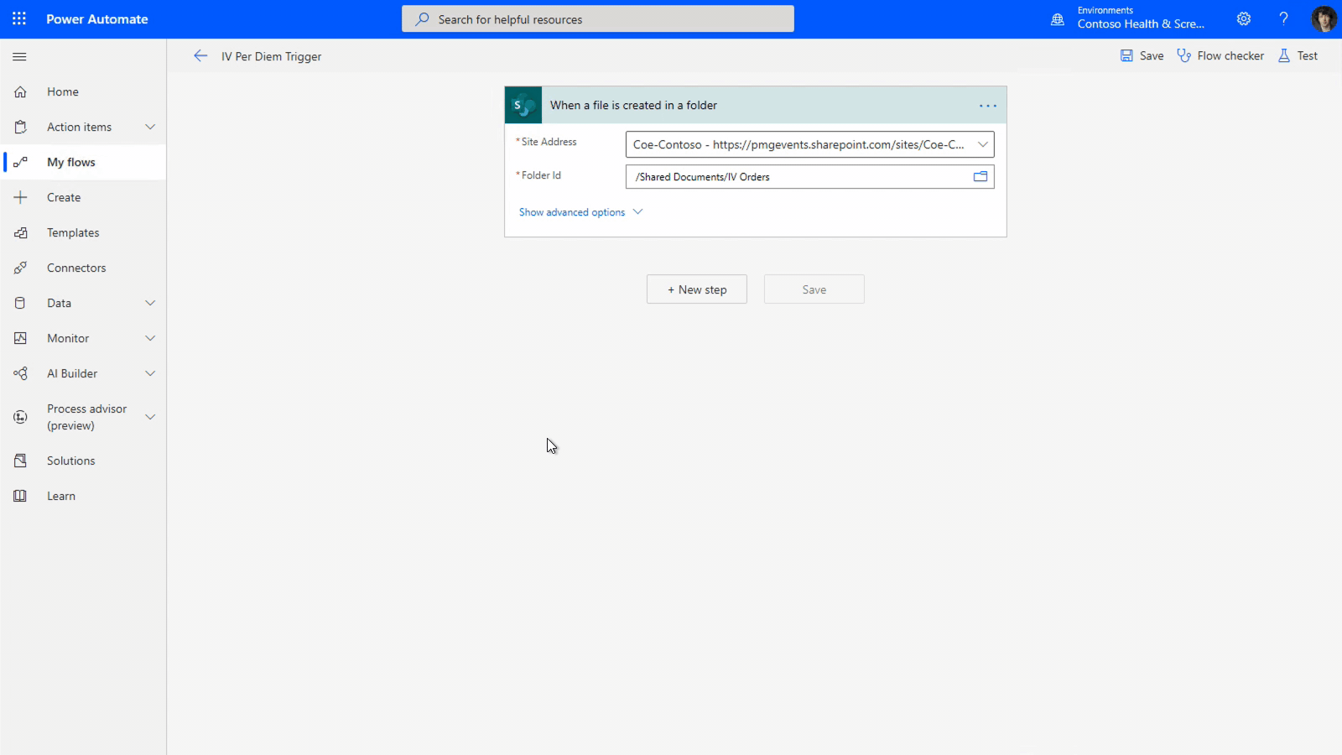
Power Automate Automate business processes across Power Platform
Expand and improve business processes with integrated RPA workflows.
Send automatic reminders for past due tasks.
Move business data between systems on a schedule.
Connect to over 300 other data sources or any publicly available API.
Create a flow once and enable makers to use it across the Power Platform.
Notes:
Automation takes a new meaning with Power Automate, which enables users to model business processes across your applications and services with an easy to use and efficient Power Platform product.
With Power Automate, citizen developers interacting with legacy applications (or older applications) can create RPA-driven automation solutions that extend and innovate on top of existing legacy systems to modernize legacy business processes.
Users can also automate repeatable, low value-added manual processes and workflows and spend more time on higher value-added work. In short, take care of what’s important and automate the rest.
Whether it is building time-saving workflows like setting automatic reminders for past due tasks or moving business data between systems on a schedule, Power Automate allows you to streamline repetitive tasks and paperless processes and turn outdated into automated.
Seamless integration using hundred of prebuilt connectors helps you save time and boost productivity and empowers everyone to build secure workflows with a low-code, no-code guided experience to automate routine tasks with robotic process automation (RPA).

Slide 10
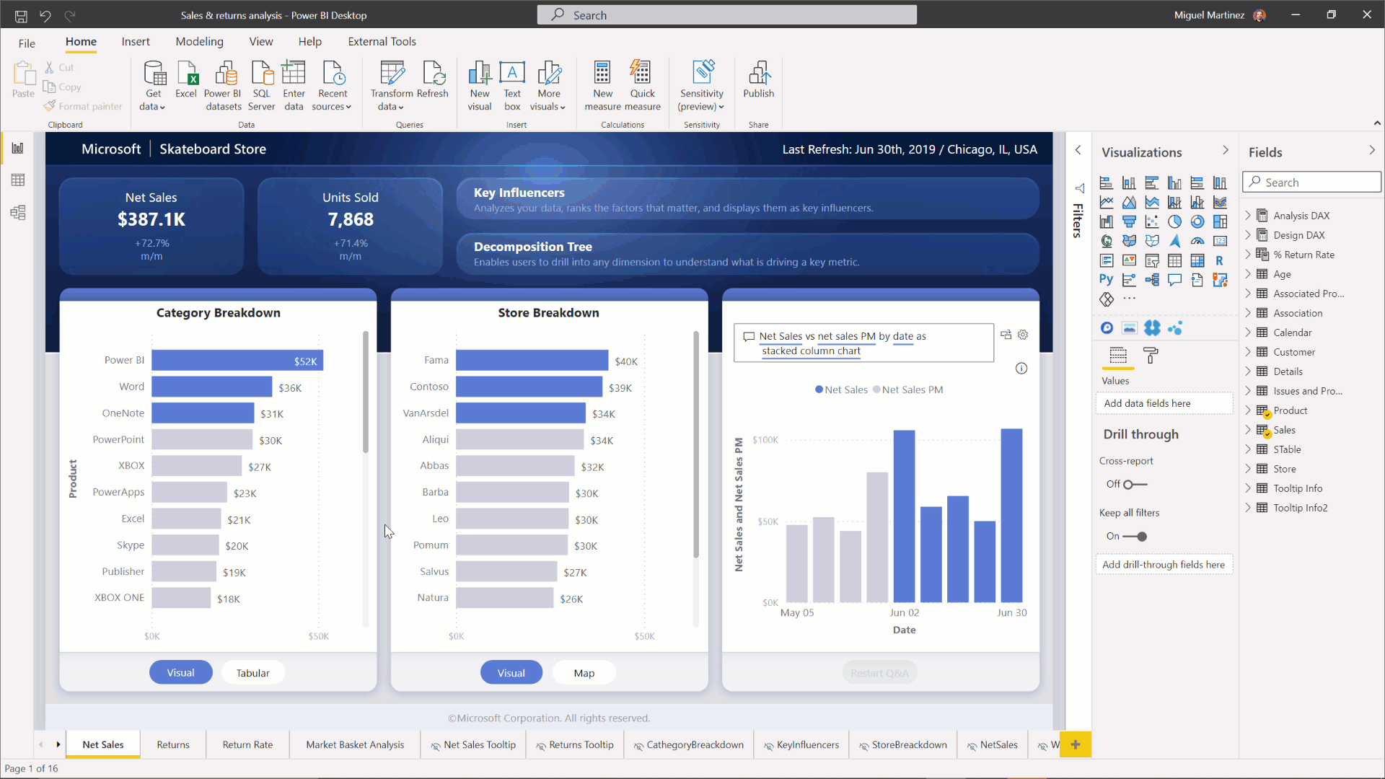
Power BI AI infused experiences with the familiarity of Office
Enable everyone to create real time dashboards & interactive reports using low-code tools and pre-built formats.
Empower end-users to explore and personalize visuals based on their unique needs.
Add dynamic, interactive narratives to reports with the flexibility to edit language and format.
Notes:
Not all workers across teams are equipped with the skills to understand data and discover actionable insights hidden in your data that can drive business results. Microsoft Power BI enables you to create a data-driven culture where everyone in your organization can make confident decisions with real-time analytics.
Power BI offers capabilities to help you discover and explore insights from your data including automated machine learning for predictive modelling, new AI visualizations with decomposition trees for detailed root cause analysis drill downs, and easier ways for everyone to interact with their data using the new Q&A visualization.
With Power BI, you can reduce added costs, complexity, and security risks of multiple solutions with an analytics platform that scales across your organization.
Hundreds of data visualizations, built-in AI capabilities, and prebuilt custom data connectors help team members create real-time dashboards and interactive reports leveraging familiar tools such as PowerPoint and Excel.

Slide 11
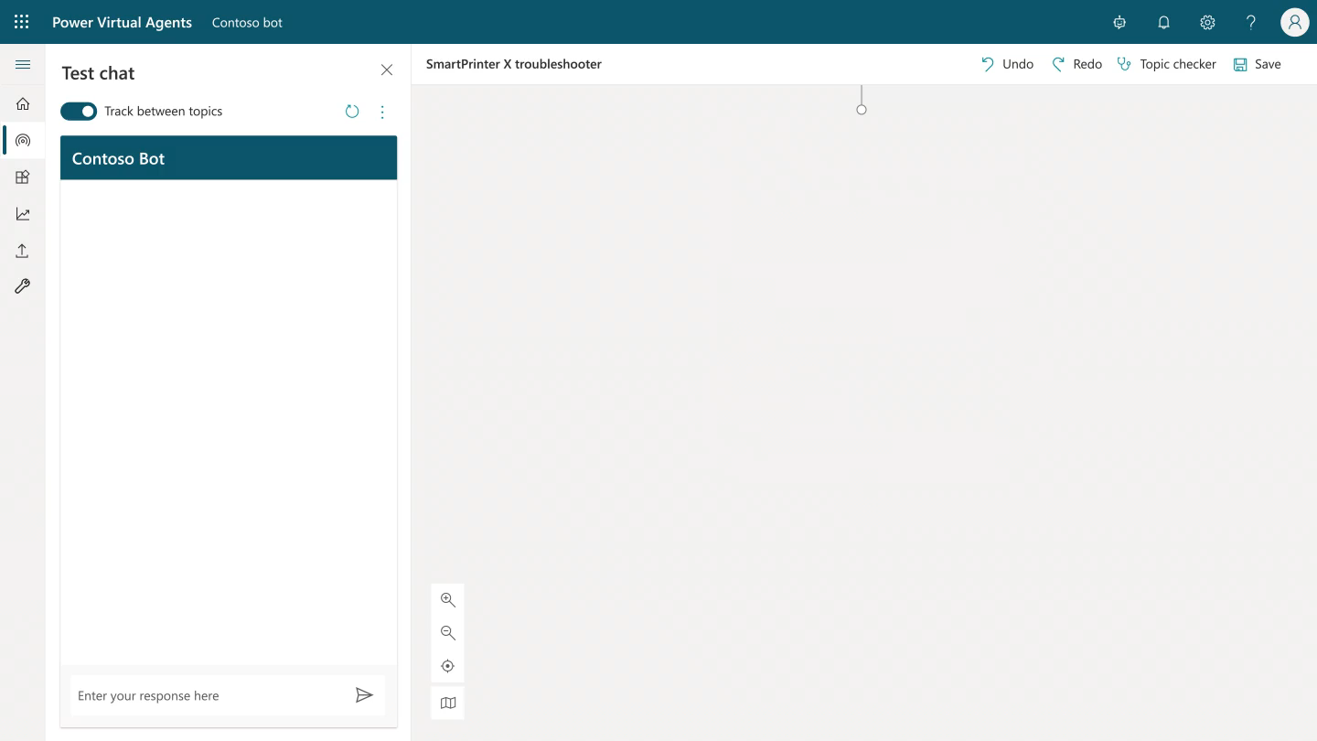
Power Virtual Agents Automate business processes across Power Platform
Create and manage powerful chatbots – without the need for code or AI expertise – with an easy-to-use graphical interface.
Easily integrate your chatbots with the products and services you use every day.
Look up records, personalize conversations, hand off conversations to live agents, and call APIs.
Choose from hundreds of prebuilt connectors, build custom workflows using Power Automate, or create complex scenarios with Microsoft Bot Framework.
Monitor and improve your chatbot’s performance using AI and data-driven insights.
Notes:
Easily building intelligent chatbots is accessible and doable for more than just professional developers with advanced technical knowledge. Microsoft Power Virtual Agents empowers everyone to do it easily, no coding required.
Power Virtual Agents empowers teams to easily create powerful bots using a guided, no-code graphical interface without the need for data scientists or developers. It eliminates the gap between the subject matter experts and the development teams building the bots, and the long latency between teams recognizing an issue and updating the bot to address it.
Chatbots can easily be integrated with the products and services teams use on a daily basis. Team members can choose from hundreds of prebuilt connectors, build custom workflows using Power Automate or even create complex scenarios using Microsoft Bot framework.

Slide 12
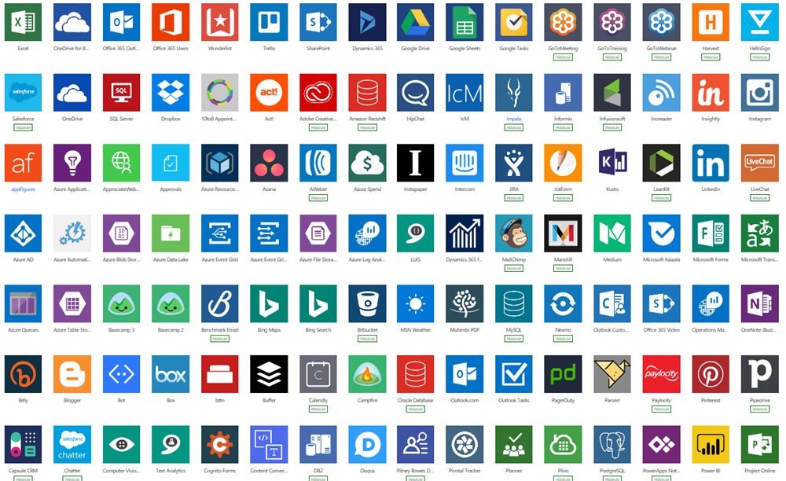
Pre-built connectors Connect to Microsoft and third-party data sources with ease
Built-in connectivity to 350+ cloud services, content services, databases, APIs, etc.
Seamless hybrid connectivity to on-premises systems via the on-premises data gateway.
Develop and register custom connectors as a building block for citizen developers.
Connect data silos by using multiple data sources in a single application.
Connect data silos by using multiple data sources in a single application.
Notes:
There are 300+ connectors that make it easy for application builders to connect to both Microsoft and 3rd party services, from Dynamics 365 to Dropbox. The connectors allow canvas apps and flows to easily use API (application programming interfaces) services without any developer knowledge. Custom connectors can also be configured to allow use of APIs that aren’t covered by the public connectors.
Connectors are essentially proxy wrappers around the application programming interfaces (APIs) provided by services that allow the power platform to easily interact with the service. Connectors can be either public or custom. There are currently over 300+ public connectors that can be used by all organizations. Examples of public connectors are Microsoft 365 (formerly Office 365), Common Data Service, Salesforce, SAP and more.

Slide 13
AI Builder Low-code AI for apps and processes
Low-code AI solutions for Power Platform leveraging the power of Azure AI.
Native integration with Common Data Service enables data from CDS, Azure Data Lakes.
Leverage predictions directly from Common Data Service across your Power Platform solutions, Dynamics 365, or Microsoft 365.
Prediction
Vision
Vision
Language
Binary classification
Predict and classify fields in Dataverse.
Forms processing
Extract structured data from digital paper, PDFs, and forms.
Object detection
Detect any object (via custom training) through camera or image control.
Text classification
Classify, group and categorize any text in CDS.
Notes:
AI Builder is a Power Platform capability that allows easily adding AI or Artificial Intelligence to the Power Platform. AI Builder provides AI models that are designed to optimize your business processes. AI Builder enables your business to use intelligence to automate processes and glean insights from your data in Power Apps and Power Automate. With AI Builder, you don't need coding or data science skills to access the power of AI. You can build custom models tailored to your needs, or choose a prebuilt model that is ready to use for many common business scenarios.

Slide 14
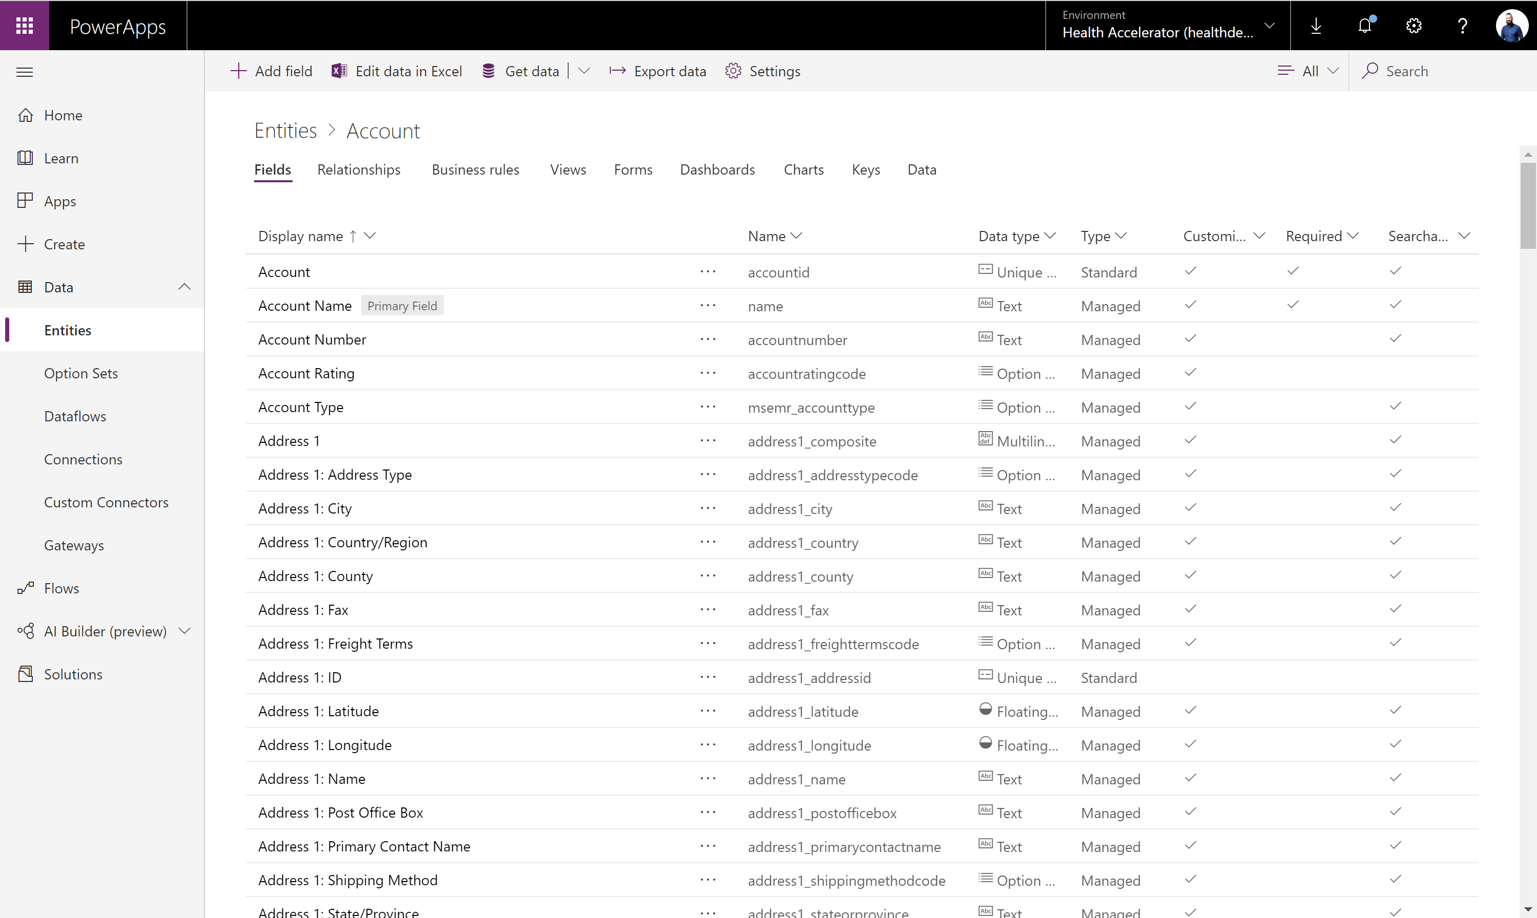
Microsoft Dataverse Put all your data to work
Jumpstart apps using an extensible data model with business logic, security and integration built in.
Extend data and processes to external and anonymous users with Power Apps portals.
Support all your data: relational data, file and blob storage, logs and search indexing.
Effortless Dynamics 365, Office 365 and Azure integration as well as powerful integration capabilities.
Notes:
Microsoft Dataverse is a scalable data service and app platform which lets users securely store and manage data from multiple sources and integrate that data in business applications using a common data model to ensure ease and consistency to users. Microsoft Dataverse is the common currency that enables the components of Microsoft Power Platform to work together. It’s the foundation that enables the consolidation, display, and manipulation of data.
Data within Dataverse is stored within a set of tables. A table is a set of rows and columns. Each column in the table is designed to store a certain type of data, for example, name, age, salary, and so on. Dataverse includes a base set of standard tables that cover typical scenarios, but you can also create custom tables specific to your organization and populate them with data by using Power Query. App makers can then use Power Apps to build rich applications that use this data.

Slide 15
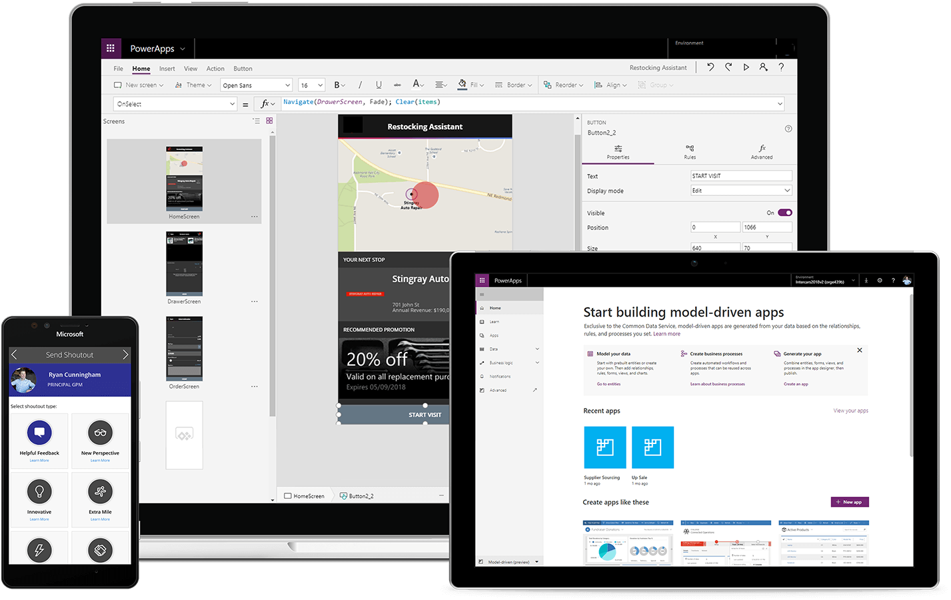



Power Platform: An intuitive, flexible, platform of low-code tools
Drive low-code transformation
Build solutions faster by exposing technology and data to more people through a safe, governable environment.
Empower everyone to imagine, build, and launch solutions
Empower everyone to create innovative business solutions in hours - not months – with familiar tools.
Unlock developer productivity and innovation
Empower developers to build solutions faster and at-scale while using preferred development environments.
Define a new collaboration model
Increase collaboration between business and IT teams and inject more flexibility into your organization.
Notes:
In summary, the Power Platform is an intuitive, extensible platform of low-code tools that empowers all users to collaborate and build transformational solutions. Break up silos and democratize access to technology and data. Surface insights and create flexibility in business processes. Proactively create innovative, scalable solutions. All in the secure, trusted Microsoft Cloud.
With Microsoft Power Platform, you can build solutions on top of legacy systems, cloud-based data or any other data source. You can empower the people closest to the problem — business users, citizen developers — to solve problems themselves by building low-code apps, workflows, data solutions as well as customizations and extensions to M365 and D365. You can also enable professional developers, data scientists, students IT teams, anyone and others to develop business solutions faster, cheaper and while continuing to use their preferred tools, languages and development environments. With Power Platform everyone, regardless of their technical capability, can work together on the same platform – speaking the same language – to create solutions with a high level of agility.
Not only is Power Platform a turnkey solution that is helping businesses face structural shifts and ensure business continuity, it is empowering everyone to do more with low-code transformation.

Slide 16
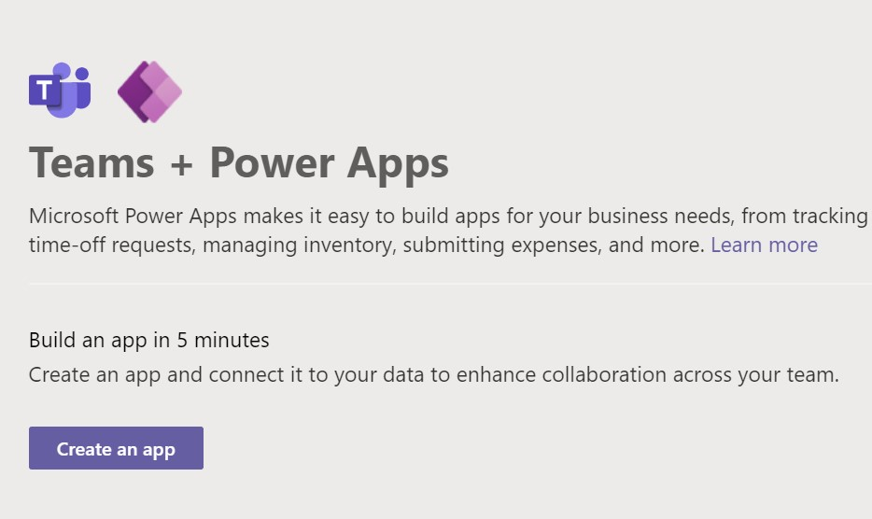
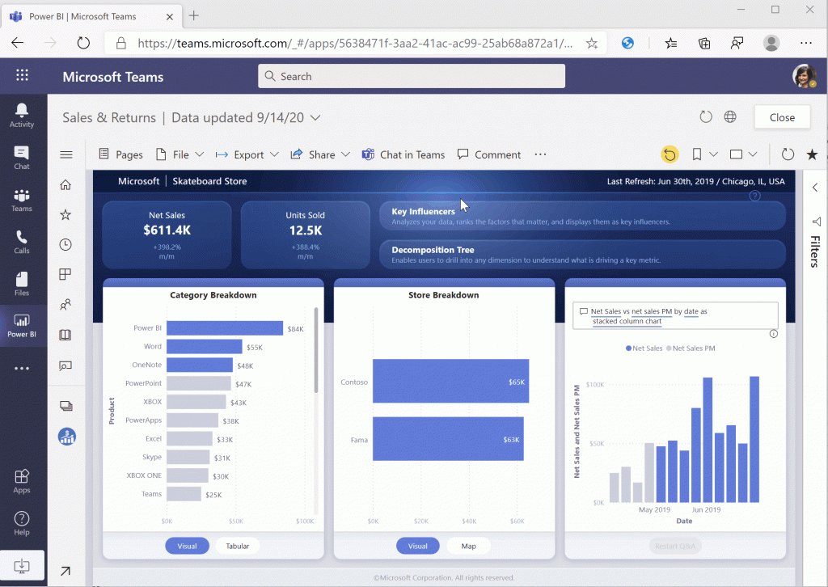
Power Platform integration with Microsoft Teams
Leverage the rich Teams environment to accelerate growth
Leverage the dedicated Power BI add-in application for Microsoft Teams to browse reports, dashboards, and workspaces
Directly embed links to Power BI applications in Teams channel chats and browse Power BI datasets for analyzing data and generating reports
Utilize the Power Apps app in Teams to create canvas apps within Teams backed by Project Oakdale to build custom apps, bots, and workflows
Integrate business data from a wide variety of sources, including CDS, embedding a canvas app as a tab app in Teams via PowerApps tab for Teams
Notes:
With the rise of a remote everything world, Teams has become a major place where work gets done. People in the workplace are using teams, students in university are using Teams. So why not bring this productivity applications right into the place where you work everyday. From collaboration and meetings to ongoing workspaces and communication channels, Teams is the hub of productivity.
Augment with Power BI integration with Teams also.
This integration of Power Platform and Teams, delivers a built-in low code data platform for Microsoft Teams, and provides relational data storage, rich data types, enterprise grade governance, and one-click solution deployment.
Microsoft Teams and the Power Platform is shaping the future of work with low-code apps to run the business. The new functionality enables users to easily build applications and bots directly within Teams, empowering business users to rapidly respond to changing business needs and create custom solutions. With the addition of Project Oakdale, Teams users now have key business data at their fingertips to build new apps that address real business problems—all without ever leaving Teams.

Slide 17
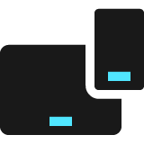

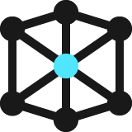
Build solutions for any use case Work with a scalable platform flexible enough to solve your business challenges, with IT in control, and robust security and governance via Power Platform Admin Center
Basic
Complex
Streamline business processes
Work across business units
Modernize your entire business
Automate paper processes & manual data collection
Extend Office 365 and Dynamics 365 apps and data
Build mission-critical apps and departmental solutions
Update legacy apps
Deliver immersive, complex platform modernizations
Consolidate data, build advanced analytics solutions
Notes:
With Power Platform, you can create solutions that are specific and are tied to an individual user or specific workflow, all the way up to enterprise-level applications and capabilities that are deployed across thousands of users.
From apps to data dashboards, automation flows or personalized chatbots, Power Platform enables you to build low-code solutions to everyday business problems.
Beyond enabling these things, Microsoft Power Platform also leads the pack in terms of the security and governance capabilities underpinning these capabilities.

Slide 18
Power Platform Success stories
Notes:
Let’s bring your focus to a use case in action. Let’s learn about Samit Saini who was once a security guard at the London Heathrow Airport with ZERO Technical experience. Upon discovering Power Apps and the Power Platform, he changed the way Heathrow operated. Let’s watch.

Slide 19


Slide 20
Power Platform resources
WATCH: Student Ambassadors share their low code QnA bot for Microsoft Teams
- https://youtu.be/flAOtxvOyvY
Getting Started
- https://aka.ms/PowerPlatformResources
Read More Customer Stories
- https://aka.ms/PowerPlatformStories
Notes:
And with that use case, we can see the power of the power platform put to work in the real world. From my understanding, there will be deep dive sessions taking place later today and tomorrow which will cover the all you need to know and the how of each of these products so that you too can innovate and create solutions to some of the manual processes that you have to undergo in your everyday work.
For now, here are some links to….(Talk about links)

Slide 21
Thank you.
Powerful alone. Better together.

